Slide 1
Data, Machine Learning, and AI
Introduction to FinTech
Prof. Xiaoyu (Joanna Wang)
Peking University

Slide 2
Readings
‘Artificial intelligence and machine learning in financial services’ Financial Stability Board (Executive Summary & Sections 1 - 3)
‘The Growing Impact of AI in Financial Services: Six Examples’ Arthur Bachinskiy, Medium
2

Slide 3
Readings
‘Artificial Intelligence Applications in Financial Services’ Oliver Wyman (Section on ‘How is AI Applied in Financial Services?’)
‘Artificial Intelligence & Financial Services – Fall 2019 Report’ Mayer Brown (Section on ‘AI and Big Data Regulatory Risks Under Banking and Consumer Financial Laws’)
‘Fintech: Understanding AI Use in Financial Services’ Julie Stackhouse, St. Louis Federal Reserve Bank

Slide 4
Study Questions
How do new forms of AI enabled data analytics, pattern recognition, chatbots, natural language processing, and robotic process automation fit within other emerging FinTech trends?
How has it affected the competitive landscape of financial incumbents, big tech firms and fintech startups?
What new public policy challenges are AI and machine learning presenting for the fairness, explainability, privacy, robustness, and resiliency of the financial sector? How do and should these new applications and tools fit within the regulatory structure of the financial industry?

Slide 5
Study Questions
What are artificial intelligence, machine learning and deep learning? How do these enhanced tools of pattern recognition and decision making relate to financial services?
What is natural language possessing? How has it already enhanced user interfaces (UI) and user experiences (UX) in finance? How might chatbots, conversational interfaces and voice assistants transform UI & UX in the future?
What sectors within the financial services sector has seen the most adoption of AI & machine learning? How can it be used to enhance compliance systems, customer interfaces, risk management, underwriting and investment strategies?
3

Slide 6
AI, Big Data and Machine Learning
‘The application of computational tools to address tasks traditionally requiring human sophistication is broadly termed ‘artificial intelligence’
‘‘Big data’ is a term for which there is no single, consistent definition, but the term is used broadly to describe the storage and analysis of large and/or complicated data sets using a variety of techniques including AI.’
‘Machine learning may be defined as a method of designing a sequence of actions to solve a problem, known as algorithms, which optimise automatically through experience and with limited or no human intervention.’
9
Source: ‘Artificial intelligence and machine learning in financial services’ FSB (November 1, 2017)

Slide 7
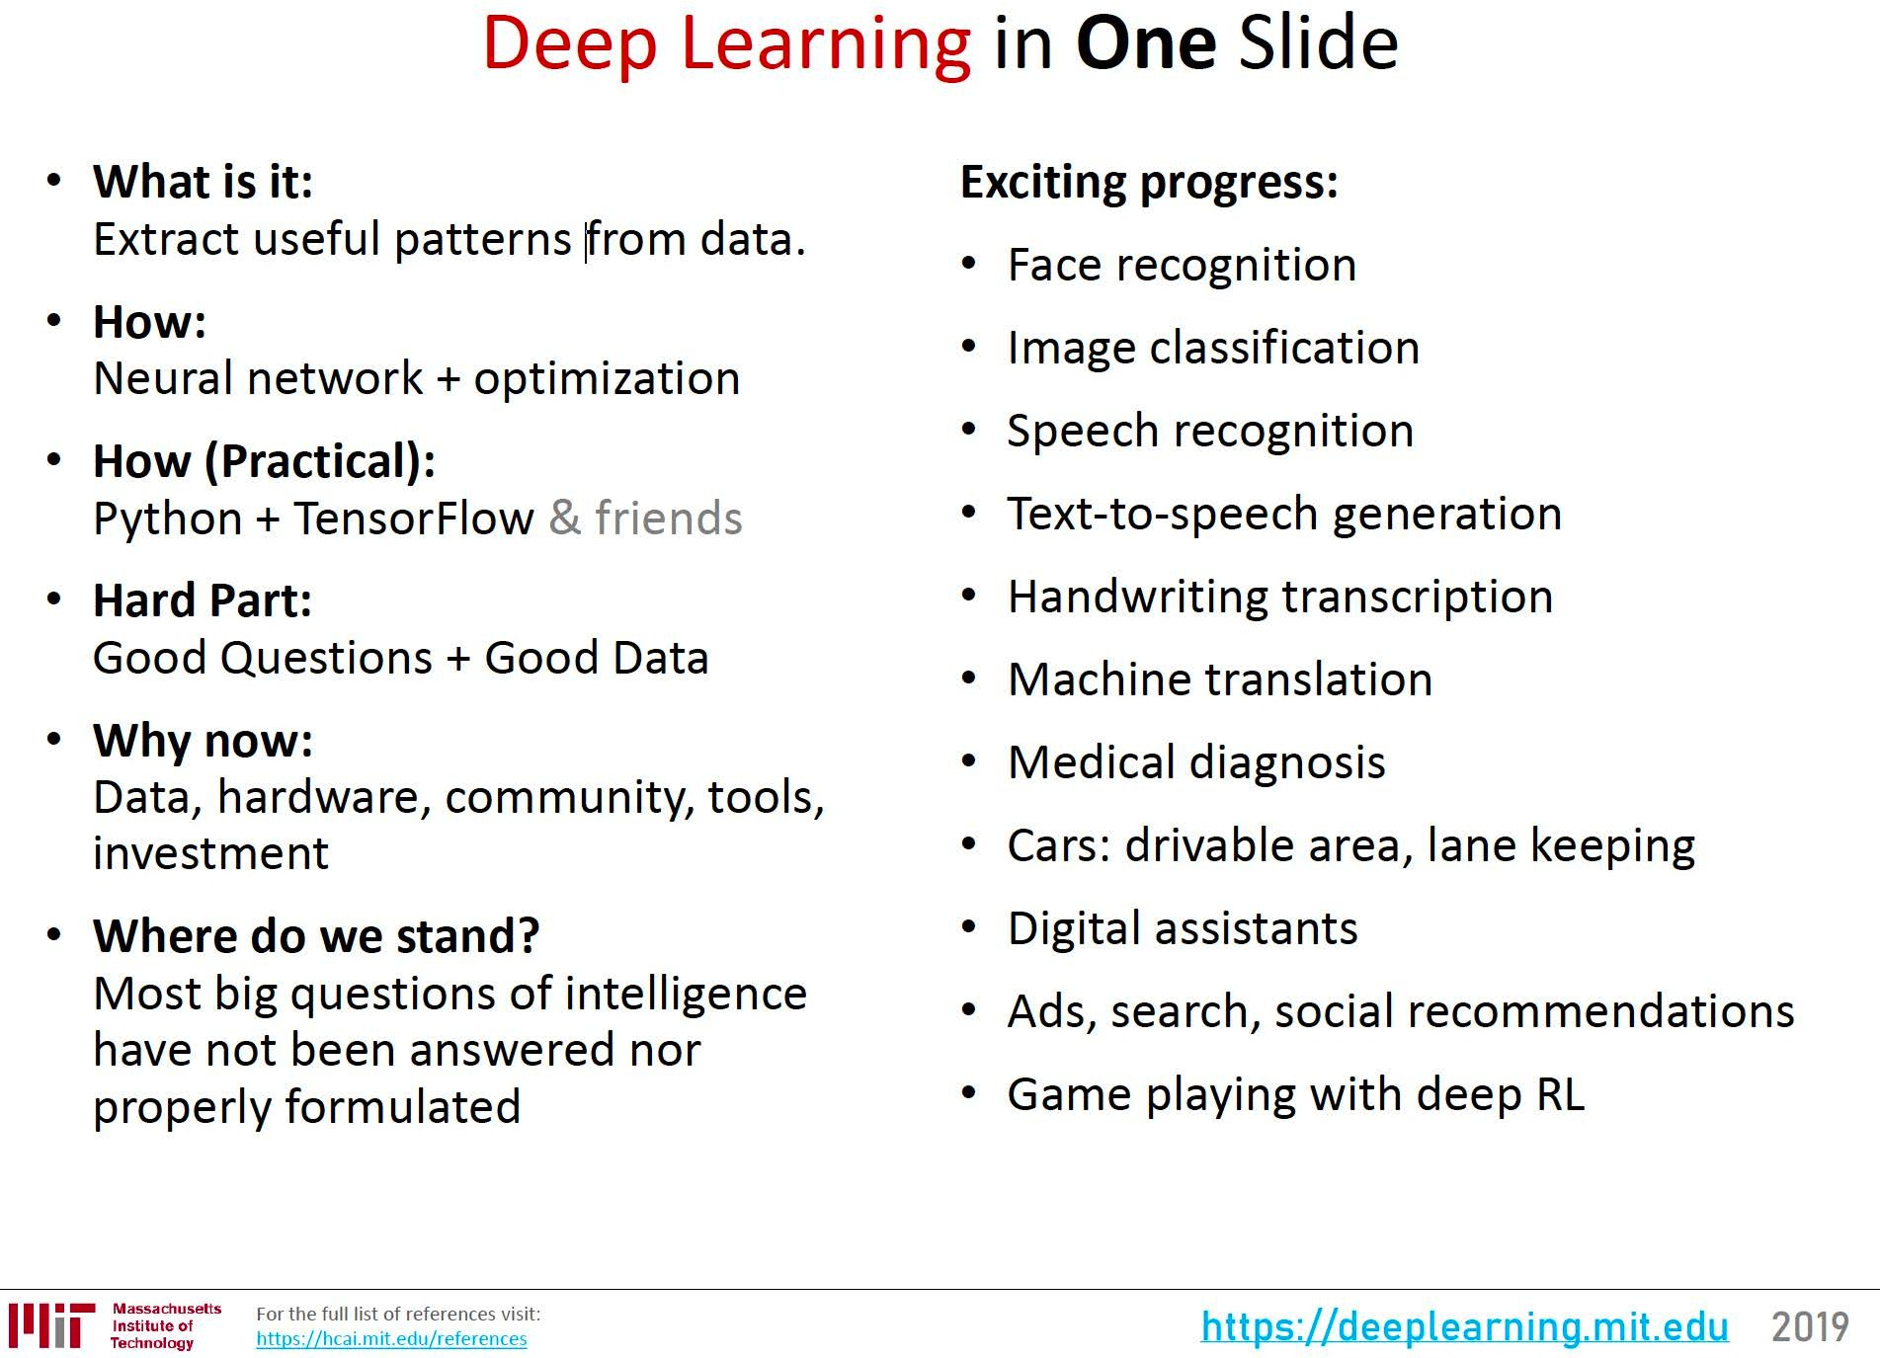
AI and Machine Learning
5
Source: ‘Deep Learning Basics’ Lex Fridman. Used with permission

Slide 8
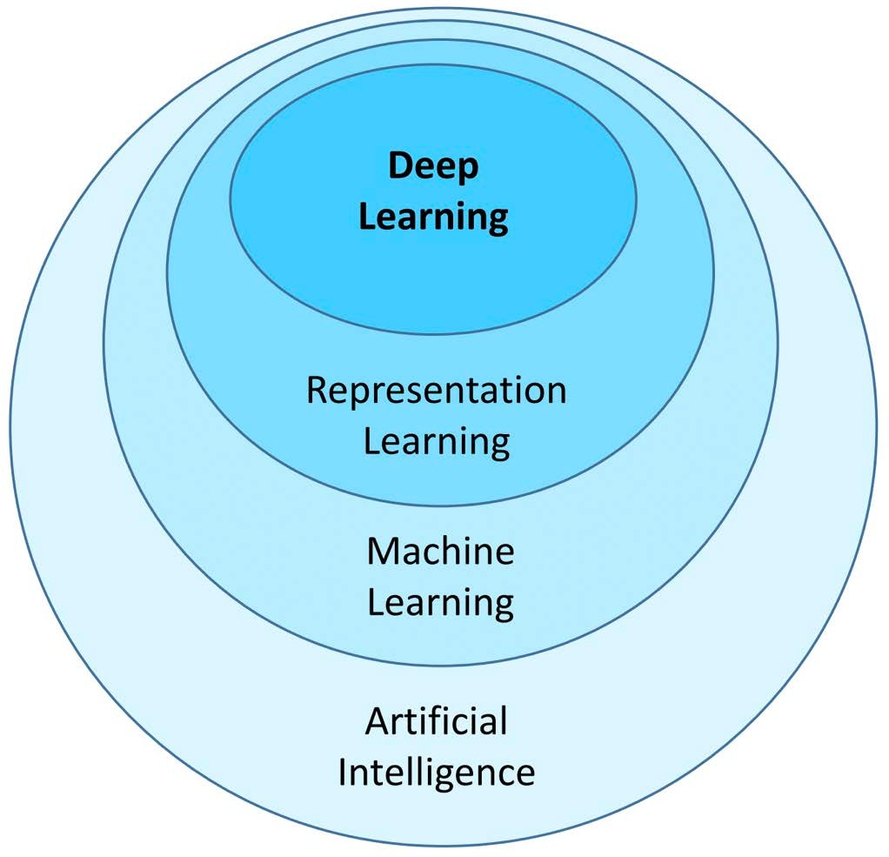
AI and Machine Learning
DL - => 2010’s => ML with Multi-layer Neural Networks
RL – ML Extracting Features of Data Sets
ML – 1980’s => Machines Improve with Experience
AI – 1950’s => Computers Mimic Human Intelligence
6
Image by Lex Fridman. Used with permission.

Slide 9
Alternative Data
Bank, Checking, Employment, Income, Insurance, Tenant, Utilities
Cash Flow Underwriting
Consumption and Purchase Transactional Data
App Usage, Browsing History, Email Receipt, Geolocation, Social Media Data,
Educational Background, Employer, Occupation, Work History
7

Slide 10
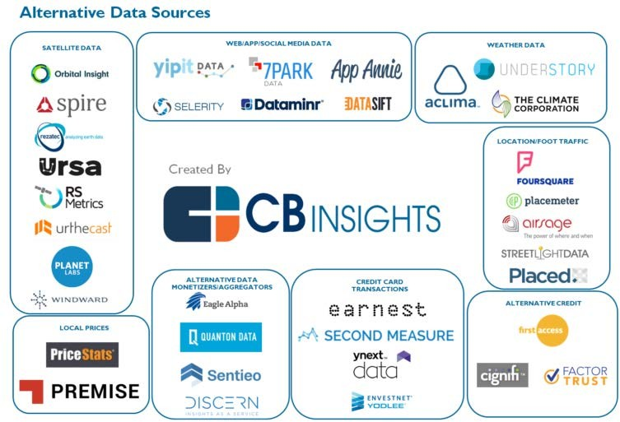
Alternative Data FinTech Landscape
© CB Insights. All rights reserved. This content is excluded from our Creative Commons license. For more information, see https://ocw.mit.edu/help/faq-fair-use/
14
Source: ‘Alternative Data Goes Mainstream in Financial Services’, Datanami (11/21/19)

Slide 11
Natural Language Possessing
Computer Input, Interpretation and Output of Human Language
Natural Language Understanding and Natural Language Generation
Audio, Image, Text and Video including Spoken, Written or Gestured
Content Generation, Content Summarization, Information Retrieval, Intent Parsing, Sentiment Analysis, Speech Generation, Speech Recognition and Translation
Chatbots, Conversational Interfaces and Voice Assistants
8

Slide 12
Customer Interface
Chatbots, CI & Voice Assistants (2010s)
Open APIs (2000s) & Open Banking (2015)
Contactless & Cardless Systems (2000s) >
Mobile Payments (2000s) & Wallets (2008) >
Internet (1990s) & On-line Banking (1990s - 2000s) >
Automatic Teller Machines (1970s) >
Credit Cards (1940 – 50s) & Point of Sale Systems (1980s) >
Mortgage Brokerage (1890s) & Automobile Indirect Lenders (1910s) >
Electronic Payments (1870s), Wires (1910s), ACH (1970s) & Direct Deposits (1970s) >
Checks (800s), Negotiable Checks (1500s), & Preprinted Checks (1760s) >
Banking - Tents, Temples, Bricks & Mortar (4th – 1st millennium BCE) >
10

Slide 13
Funding & Risk Management
ML Based Underwriting (2010s) >
Peer to Peer Lending (2005) >
Credit Default Swaps (1990s) >
Asset Backed Securitizations (1970s – 90s) >
Interest Rate Futures (1970s) & Interest Rate Swaps (1980s) >
Consumer Credit Scoring (1960s) & FICO Scores (1990s) >
Consumer Finance Companies & Warehouse Lines of Credit (1920s) >
Private (1880s, 1950s), Government (1930s) & GSEs (1930s) Mortgage Insurance >
Bankruptcy & Secured Lending Laws, Loan Servicing & Collection Agents (Days of old) >
Bank Deposits - (Antiquity) >
11

Slide 14
AI and Machine Learning - Finance
Asset Management
Call Centers, Chatbots, Robo-Advising & Virtual Assistants
Credit & Insurance - Allocation, Extension, Pricing & Scoring
Fraud Detection & Prevention
Regulatory – Anti Money Laundering, Anti Manipulation
Risk Management & Underwriting
Robotic Process Automation
Trading
Image by Lex Fridman. Used with permission.
12

Slide 15
Natural Language Possessing - Finance
Customer Services
Chatbots, Conversational Interfaces and Voice Assistants
Process Automation
Sentiment Analysis
Objective detection
13

Slide 16

Bank of America Erica
© Bank of America. All rights reserved. This content is excluded from our CreativeCommons license. For more information, see https://ocw.mit.edu/help/faq-fair-use/
14

Slide 17
Finance Technology Stack
? Blockchain Tech, etc. ? >
Open API >
AI, ML & NLP >
Cloud >
Mobile >
Internet >
Money, Accounting, Ledgers, Joint Stock Companies, Markets, Derivatives, Electronic Messaging, Credit Cards, Securitizations, etc. >

Slide 18
AI and Machine Learning - Finance
AI as a Tool
Big Finance, Big Tech, & FinTech Disrupters
AI as a Service
AlphaSense (2011) – Search Engine
Cape Analytics (2014) – Insurance Property Risk Analytics
ComplyAdvantage (2014) – Anti-Money laundering & KYC Software
Dataminr (2009) - Market Sentiment Analysis
Featurespace (2008) – Anti-fraud Software
HyperScience (2014) – Document Processing
Tractable (2014) – Insurance Claims Processing
Zest AI (2009) – Credit Underwriting Software
Zesty.ai (2015) – P & C Insurance Risk Analytics
8
Image by Lex Fridman. Used with permission

Slide 19
AI and Machine Learning - Finance
Credit Karma (2007)
Free Credit Report Platform
$7.1B Merger announced with Intuit (February 2020)
Image by Lex Fridman. Used with permission
Nearly $1B 2019 Revenues;
106M members; 37M Monthly Active Members; 2600+ data points per member; 8 Billion Daily Model Predictions
Plaid (2013)
Open API Software & Data Aggregator
$5.3B Merger announced with Visa (January 2020)
Estimated $109M Revenues
200+ Million Accounts Linked; 11,000 Financial Cos; 2,600 FinTech Developers
Sources: ‘Intuit Acquisition of Credit Karma’ Intuit (2/24/20); ‘Visa’s Acquisition of Plaid’, Visa (1⁹ /13/20); & ‘What’s Visa Going To Do With Plaid?’, Forbes (1/20/20) for Plaid Rev. Est.

Slide 20
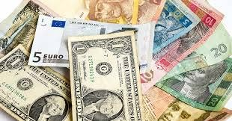
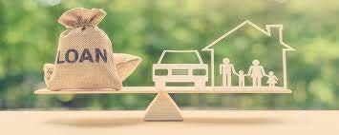
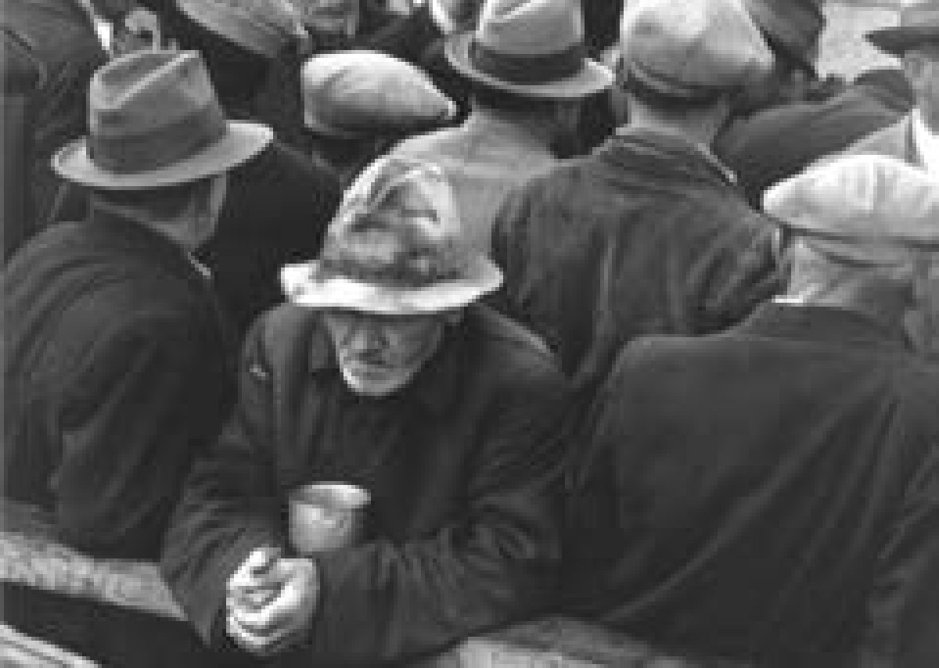





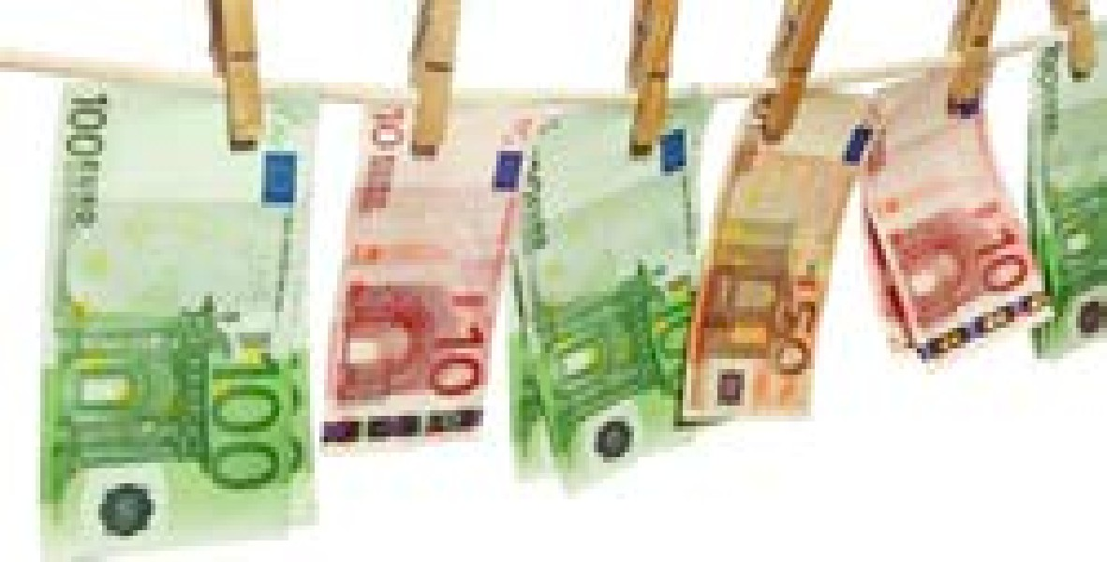


Finance Public Policy Framework
Money & Lending
Financial Stability
Protecting the Consumer & Investing Public
Guarding Against Illicit Activity
10
© Sources Unknown. All rights reserved. This content is excluded from our Creative Commons license. For more information, see https://ocw.mit.edu/help/faq-fair-use/

Slide 21
AI Policy and Finance
Biases, Fairness, and Inclusion
Explainability, Transparency, and Auditability
Privacy and Data Ownership
Use of Alternative Data
Algorithmic Correlation or Collusion ?=> Interconnectedness
Resiliency vs. Fragility
Risk Management and Oversight
How AI & ML Fits within Current Regulatory Frameworks
Principles & Guidelines generally at High level & Non-Binding₁₁

Slide 22
FinTech - Policy Alternatives
Technology Neutrality
New Activities Come within Existing Frameworks & Laws
Clarification where Application of Rules are Ambiguous
Legal and Regulatory Requirements Adjusted:
For New Activities … or Technologies
For Existing Activities
Regulatory Perimeters Moved
Promote Early Stage Activity … or Technologies (e.g. Sandboxes)
Promote via Open Banking & Competition Policy

Slide 23
AI & U.S. Consumer Credit Laws
Equal Credit Opportunity Act (ECOA)
Disparate Treatment or Disparate Impact
Regulation B on Notices on Actions
Fair Housing Act
Fair Credit Reporting Act (FCRA)
Consumer Reporting Agencies and Consumer Reports
Notice Requirements on Adverse Actions
Unfair, Deceptive, and Abusive Acts and Practices (UDAAPs) - CFPB
Unfair and Deceptive Acts and Practices (UDAP) - FTC & States

Slide 24
AI & Privacy Laws
Europe – General Data Protection Regulation (GDPR)
U.S. Federal –FCRA, Gramm Leach Bliley, & Right to Financial Privacy Act
U.S. States – California Consumer Privacy Act (CCPA)

Slide 25
AI, Finance, & Geopolitics
Finance is Interconnected Globally and Regulated Locally
Countries’ Financial Sectors Vary in Development, Concentration and Public Sector Involvement
International Organizations (OECD …) Guidelines generally at High level
Financial Policy Standard Setters (Basal, FATF, IOSCO ..) are Non-Binding
No Internationally Enforceable Standards
Competing models on AI, Finance & Policy Trade-offs

Slide 26
Outline
Big data
Machine learning
Deep learning
Large language model
Applications
Other techniques related to Artificial intelligence (AI)

Slide 27
Big Data Revolution
Exponential increase in available data
By 2015, 4.4 zetabytes (trillions of gigabytes) of digital data have been created – expected to be 10x more in 2020
Data can come from phones, internet of things, social media, satellite imaging, web searches, etc.
Increased computing power at lower cost
Cloud computing: each google search utilizes results from thousands of computers
Advancement in machine learning methods in data analytics
Machine learning, deep learning, reinforcement learning

Slide 28
Firm as a nexus of contracts
Managers
Shareholders
Creditors
Employees
Firm
Suppliers
Government
Auditors
Customers
28
Notes:
Information asymmetry between firm and other contracted parties.
Investors interested in what
How managers use accounting informaiton : managerial accounitng

Slide 29
Deep Learning &
Computational Power
Disclosure:
Firm Information
Decisions:
Investment & Managerial Decisions
Disclosure:
Firm Information
Decisions:
Investment & Managerial Decisions
Disclosure:
Firm Information
Decisions:
Investment & Managerial Decisions
Theory Development
Theory Development
Theory Development
Unstructured
Data: Texts & Images
Notes:
Unstructure data: text & imagment
Unstrucutre data cannot use OLS
deep learning; computatution power
I was CS major 7 years, move a master of finance, then accounting phd. . I have been looking for opporunties to expand my reserch. In my earlier years, I didn’t leverage too much on my computer science. My research evolves into this line of research..

Slide 30
Evolution
Income statement analytics
Balance sheet analytics
Analyst data and analyst report
Managerial Analytics: compensation
Bank loan analytics
Patent data analytics
Information
Firm disclosure
Notes:
Unstructure data: text & imagment
Unstrucutre data cannot use OLS
deep learning; computatution power
I was CS major 7 years, move a master of finance, then accounting phd. . I have been looking for opporunties to expand my reserch. In my earlier years, I didn’t leverage too much on my computer science. My research evolves into this line of research..

Slide 31
Annual report (10K) and conference call textual analysis
Firm material news (8k)
(political risk, climate risk, bank risk, personability, sentiment, many to go)
Social media analytics
(negative peer disclosure)
Mandatory Mutual fund SEC filings, e.g. Form N-CSR
CSR reports
Proxy statement
IPO Form S-1
Regulatory disclosure (SEC comment letters)
Image data
Not covered:
Media (info dissemination, private info, monitoring)
Any information within a firm
e.g. Satellite image, RPI
Machine learning that combines numerical and textual data (Tutorial videos: https://space.bilibili.com/2078445811/)
Evolution
Information
Firm disclosure
Not disclosed, but can be extracted
Notes:
Unstructure data: text & imagment
Unstrucutre data cannot use OLS
deep learning; computatution power
I was CS major 7 years, move a master of finance, then accounting phd. . I have been looking for opporunties to expand my reserch. In my earlier years, I didn’t leverage too much on my computer science. My research evolves into this line of research..

Slide 32
Incentive
Disclosure
Consequence
Investors → trading decisions
Investors extract disclosed information in order to make disclosure decisions (extract and use information)
Emerging research areas:
household investing decisions
machine learning
Notes:
Unstructure data: text & imagment
Unstrucutre data cannot use OLS
deep learning; computatution power
I was CS major 7 years, move a master of finance, then accounting phd. . I have been looking for opporunties to expand my reserch. In my earlier years, I didn’t leverage too much on my computer science. My research evolves into this line of research..

Slide 33
Incentive
Disclosure
Consequence
Corporate Decisions (manager decisions)
Investment strategy decisions (including using peer disclosures)
Labor market (CEO characteristics)
Cash Flow Management / Dividend Payout
Capital Structure
IT decisions
Corporate Social Responsibility (CSR)
Emerging research areas:
Private firms or entrepreneurship
Notes:
Unstructure data: text & imagment
Unstrucutre data cannot use OLS
deep learning; computatution power
I was CS major 7 years, move a master of finance, then accounting phd. . I have been looking for opporunties to expand my reserch. In my earlier years, I didn’t leverage too much on my computer science. My research evolves into this line of research..

Slide 34
Incentive
Disclosure
Consequence
Creditors → contract decisions
Public: bond market (more likely to use accounting information)
Private: banks
Government (SEC)
How government should regulate disclosure
Employee and CEOs
Hiring decisions
Employee performance
Auditors
Customers and Suppliers
Competitors → proprietary cost/ data
Notes:
Unstructure data: text & imagment
Unstrucutre data cannot use OLS
deep learning; computatution power
I was CS major 7 years, move a master of finance, then accounting phd. . I have been looking for opporunties to expand my reserch. In my earlier years, I didn’t leverage too much on my computer science. My research evolves into this line of research..

Slide 35
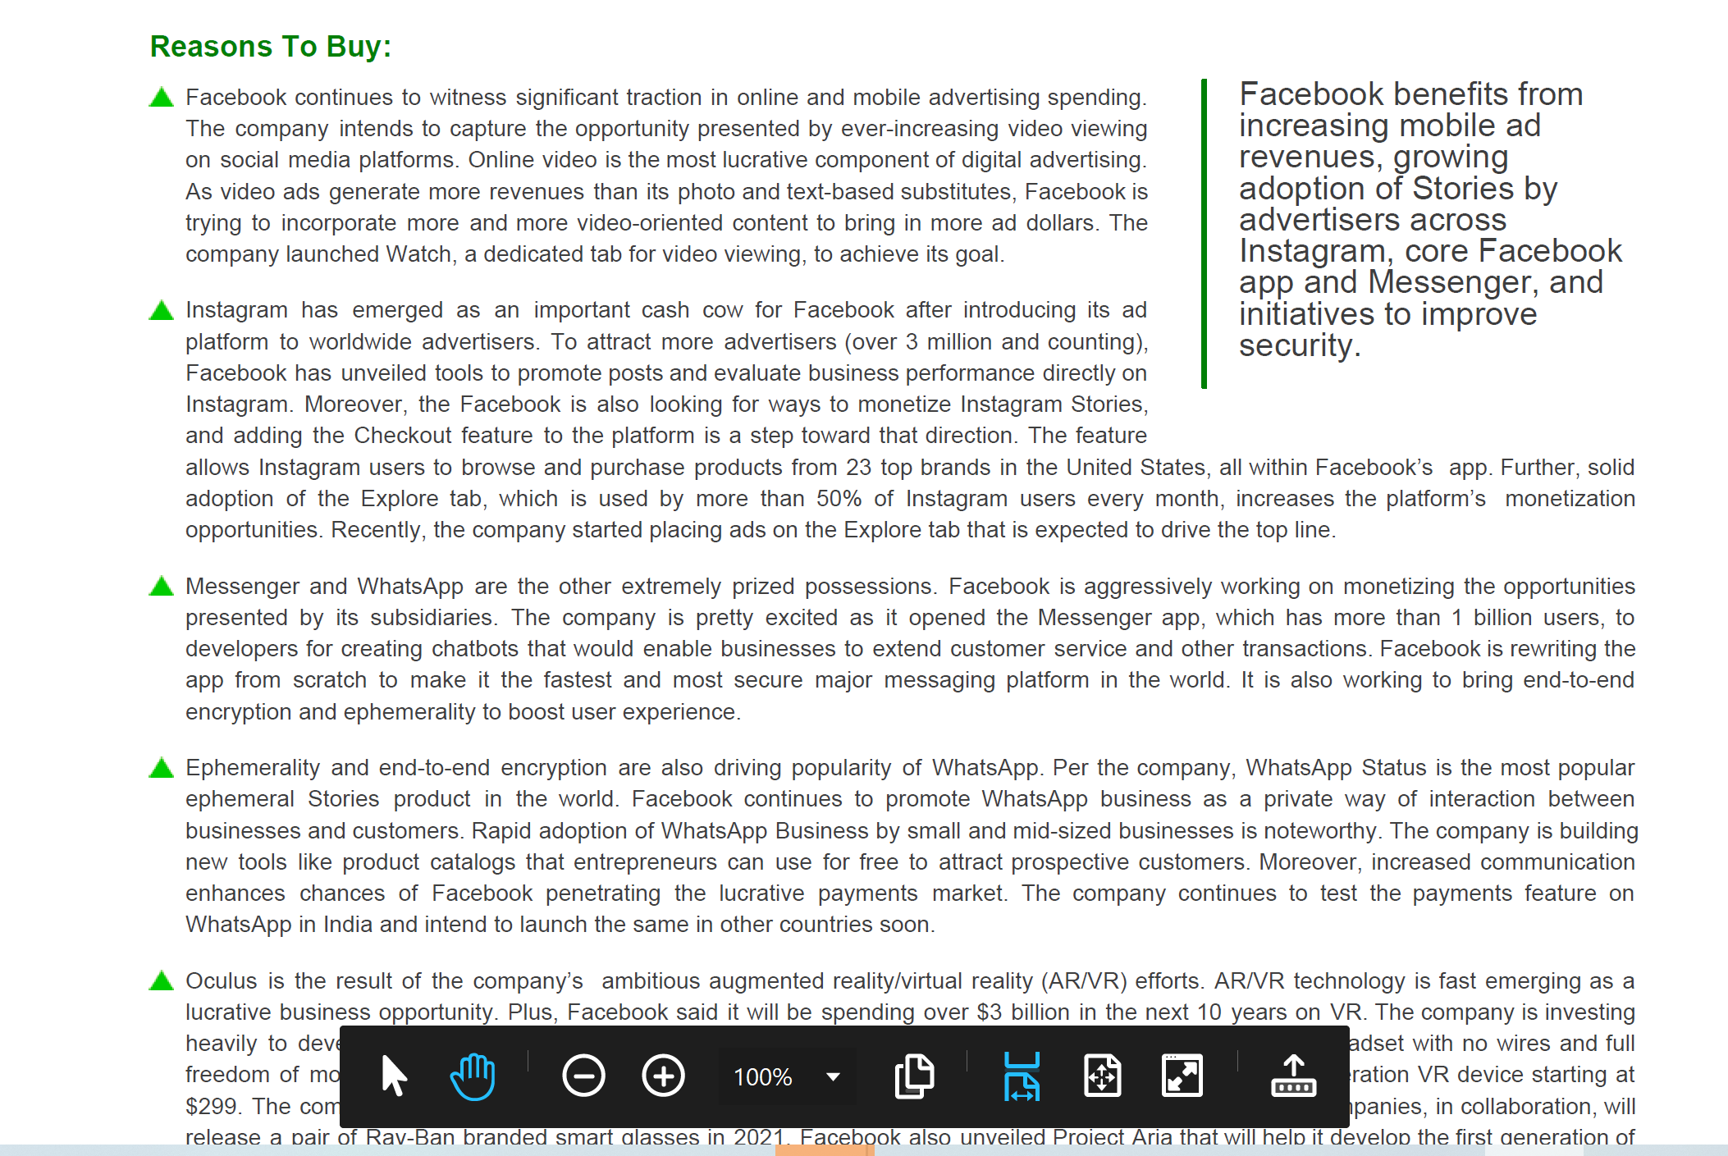
Textual data – analyst report

Slide 36
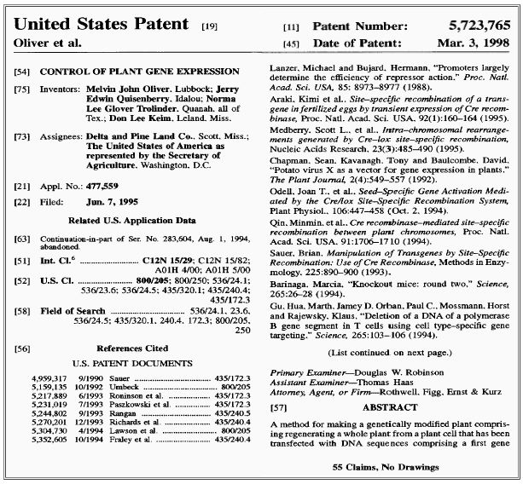
Textual data – firm innovation

Slide 37
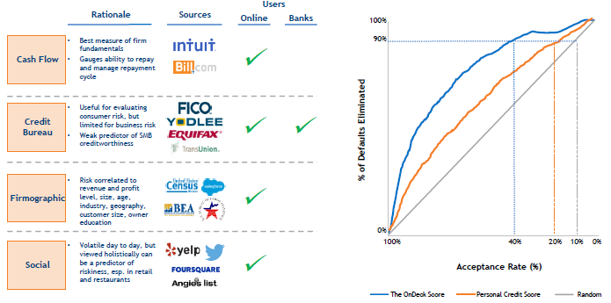
Tech enabled New data from Loan market
Source: OnDeck

Slide 38
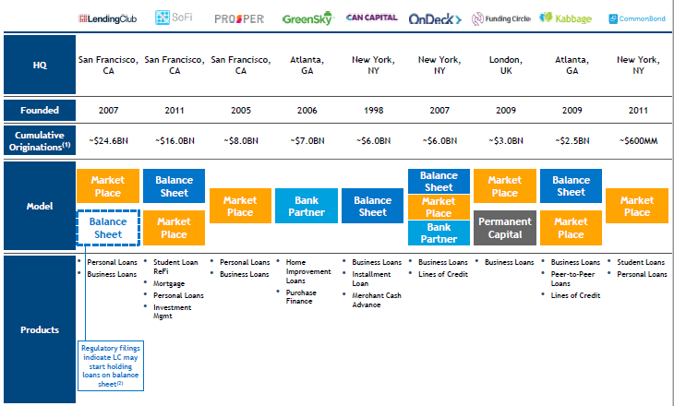
Tech-Enabled Lending
Source: SunTrust

Slide 39
Lenders
Balance sheet: Well, they hold the money they lend on their balance sheet. They have bought or borrowed it at a cost to then lend out to their customers. As it’s their money, the lender takes on all the risk.
Banks are the prime example of balance sheet lenders. Less well known is that many of the fintechs are also balance sheet lenders.
Marketplace: A service that enables investors (lenders) to lend money to borrowers directly. A marketplace provides the infrastructure required to facilitate the funding arrangement. Both parties generate value, with investors earning yield and borrowers getting the funding they require.
Marketplace lending in different forms covers all lending types and holds a fifth of the market share in regions such as the UK and US.

Slide 40
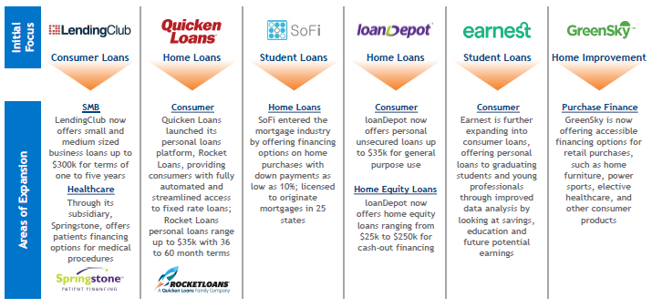
Tech-Enabled Lending Expand into New Areas
Source: SunTrust

Slide 41
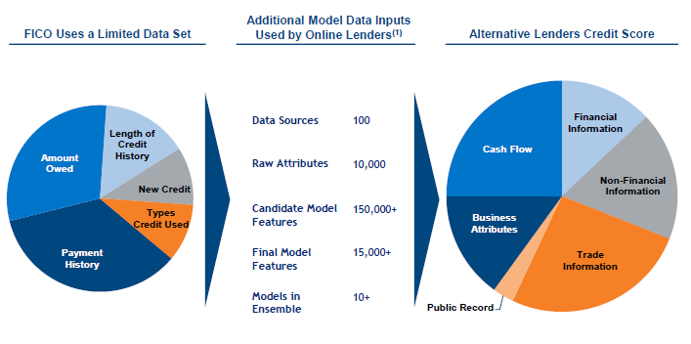
Alternative Lenders Use A Wealth of Data to Measure Risk
Source: OnDeck

Slide 42
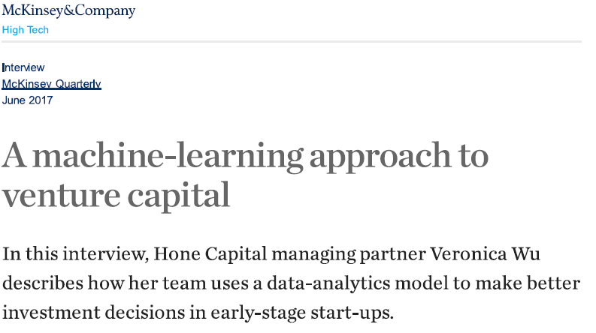
Investment Decision-Making

Slide 43
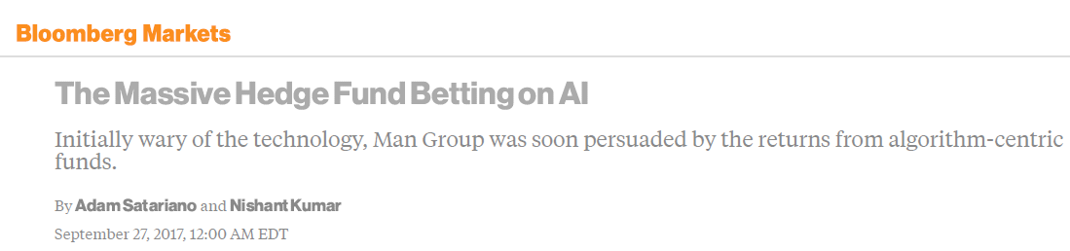
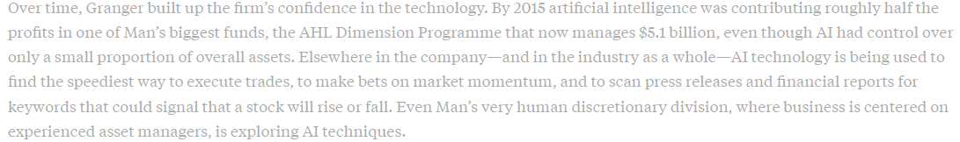

Slide 44

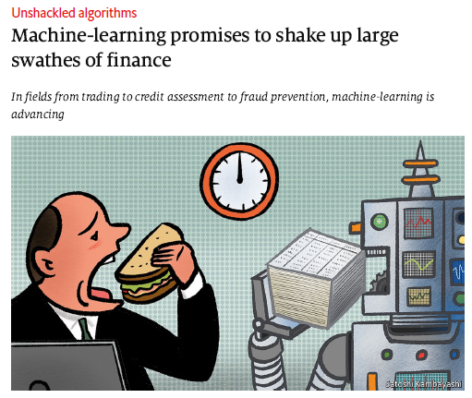
“From 2019, anyone seeking to become a ‘chartered financial analyst’, a sought-after distinction in the industry, will need AI expertise to pass his exams.”

Slide 45
Machine Learning

Slide 46
Supervised vs Unsupervised Machine Learning
Supervised Machine Learning: classifying labeled data or predicting outcomes
Classification
K-Nearest Neighbors, Logistic Regressions, Support Vector Machines
Regressions
Linear, Lasso, Ridge, Decision Tree, Random Forest, Boosts
Unsupervised Machine Learning: analyzing unlabeled data
Clustering and Dimension Reduction
K-Means, Latent Dirichlet Analysis, Principle Component Analysis

Slide 47
Evaluating Machine Learning Models
Training Sample
Use the training sample to tune the model’s parameters
Minimize prediction errors in the training sample
Test Sample
Test the model’s performance on test sample
Overfitting
The model may fit the training sample perfectly with a large number of parameters but can perform poorly on the test sample

Slide 48
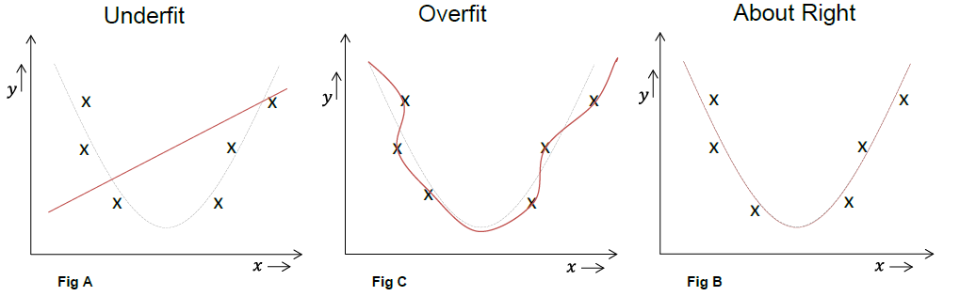
Overfitting and Underfitting
Source: J.P. Morgan

Slide 49
Cross-Validation
Cross-validation can address the overfitting problem
k-fold cross-validation
Divide the training sample into k equal subsamples
For each subsample i, use the rest of the sample (except i) to train the model, and use i as the test sample
Compute the prediction errors over subsample I
Aggregate to obtain the overall prediction errors
Since the training samples are separate from the test samples, this can avoid overfitting
Cross-validation can be used to select among different machine learning models

Slide 50
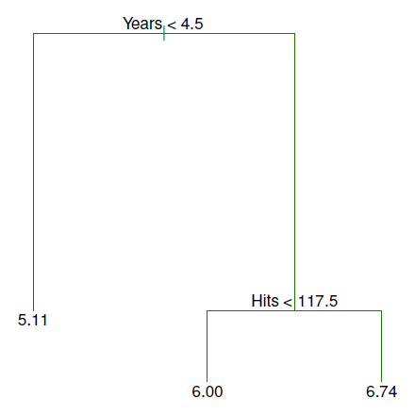
Decision Trees
Using decision trees to predict baseball players’ salary
Decision tree method splits the sample into two samples at each step

Slide 51
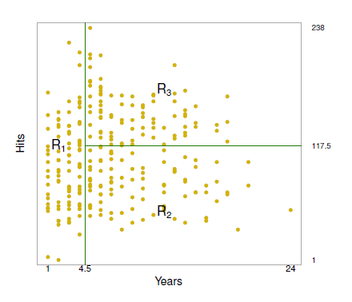
Decision Trees – Partition Regions
Decision tree analysis divide the predictor space into a number of regions
Each region corresponds to a terminal node in the tree or a leaf
R₁ ={X |Years<4.5},
R₂ ={X | Years>=4.5,Hits<117.5}
R₃ ={X | Years>=4.5, Hits>=117.5}

Slide 52
Decision Trees – Partition Regions
The predicted value for each region is the average sample values in that region
R₁: $1,000×e^{5.107} =$165,174,
R₂: $1,000×e^{5.999} =$402,834
R₃: $1,000×e^{6.740} =$845,346

Slide 53
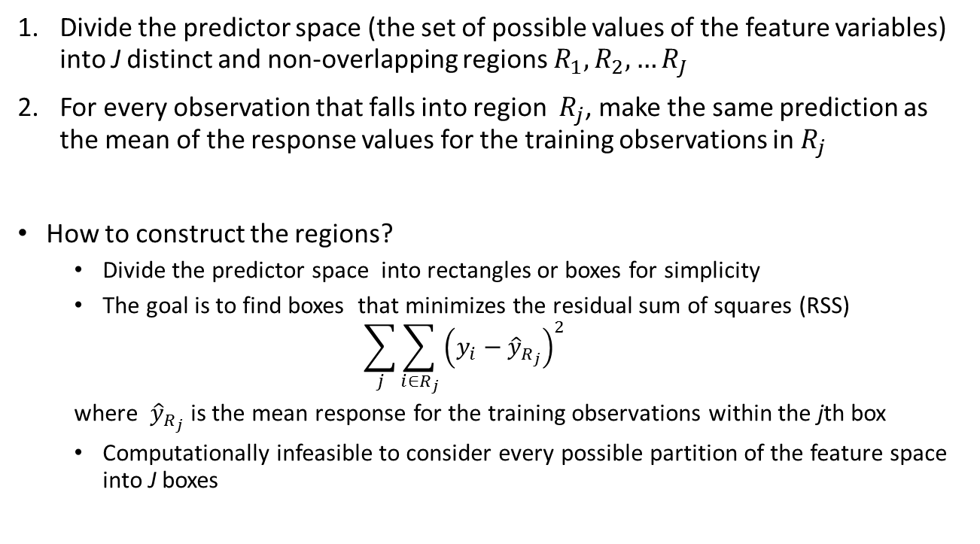
Building a Regression Tree
Divide the predictor space (the set of possible values of the feature variables) into J distinct and non-overlapping regions $R_{1},R_{2},…R_{J}$
For every observation that falls into region $R_{j}$, make the same prediction as the mean of the response values for the training observations in $R_{j}$
How to construct the regions?
Divide the predictor space into rectangles or boxes for simplicity
The goal is to find boxes that minimizes the residual sum of squares (RSS)
$$\sum_{j}{\sum_{i∈R_{j}}{{\left(y_{i}−{\hat{y}}_{R_{j}}\right)}^{2}}}$$ where ${\hat{y}}_{R_{j}}$ is the mean response for the training observations within the jth box
Computationally infeasible to consider every possible partition of the feature space into J boxes

Slide 54
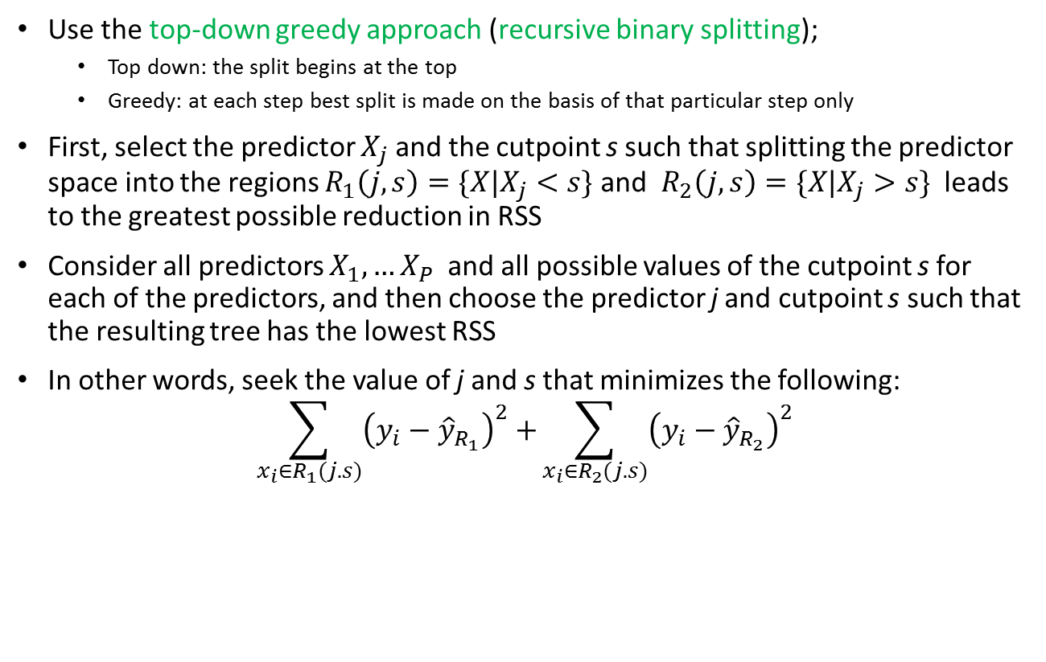
Recursive Binary Splitting
Use the top-down greedy approach (recursive binary splitting);
Top down: the split begins at the top
Greedy: at each step best split is made on the basis of that particular step only
First, select the predictor $X_{j}$ and the cutpoint s such that splitting the predictor space into the regions $R_{1}\left(j,s\right)=\{X|X_{j}<s\}$ and $R_{2}\left(j,s\right)=\{X|X_{j}>s\}$ leads to the greatest possible reduction in RSS
Consider all predictors $X_{1},…X_{P}$ and all possible values of the cutpoint s for each of the predictors, and then choose the predictor j and cutpoint s such that the resulting tree has the lowest RSS
In other words, seek the value of j and s that minimizes the following:
$$\sum_{x_{i}∈R_{1}(j.s)}{{\left(y_{i}−{\hat{y}}_{R_{1}}\right)}^{2}+}\sum_{x_{i}∈R_{2}(j.s)}{{\left(y_{i}−{\hat{y}}_{R_{2}}\right)}^{2}}$$

Slide 55
Recursive Binary Splitting
Repeat the process looking for the best predictor and the best cutpoint to split the data further to minimize the RSS within each region
At each step, split one of the previously identified regions to minimize RSS
The process continues until a stopping criteria is reached: e.g. continue until no region contains more than five observations

Slide 56
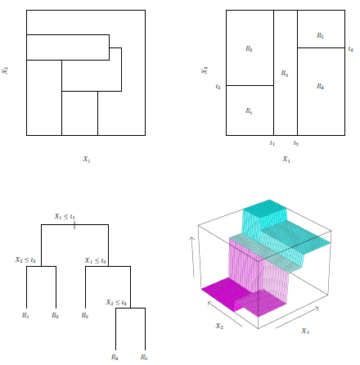
Recursive Binary Splitting: Example

Slide 57
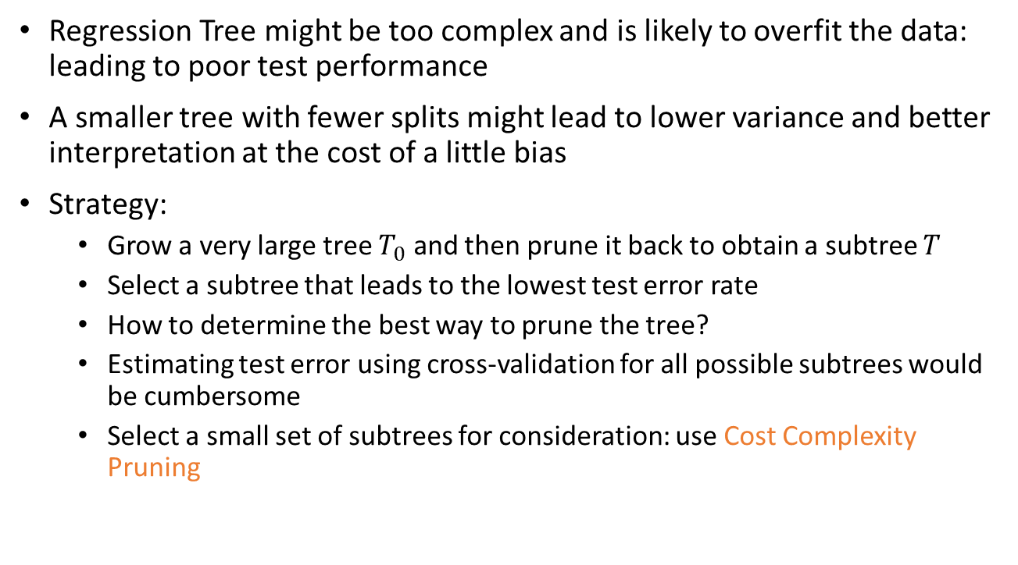
Tree Pruning
Regression Tree might be too complex and is likely to overfit the data: leading to poor test performance
A smaller tree with fewer splits might lead to lower variance and better interpretation at the cost of a little bias
Strategy:
Grow a very large tree $T_{0}$ and then prune it back to obtain a subtree $T$
Select a subtree that leads to the lowest test error rate
How to determine the best way to prune the tree?
Estimating test error using cross-validation for all possible subtrees would be cumbersome
Select a small set of subtrees for consideration: use Cost Complexity Pruning

Slide 58
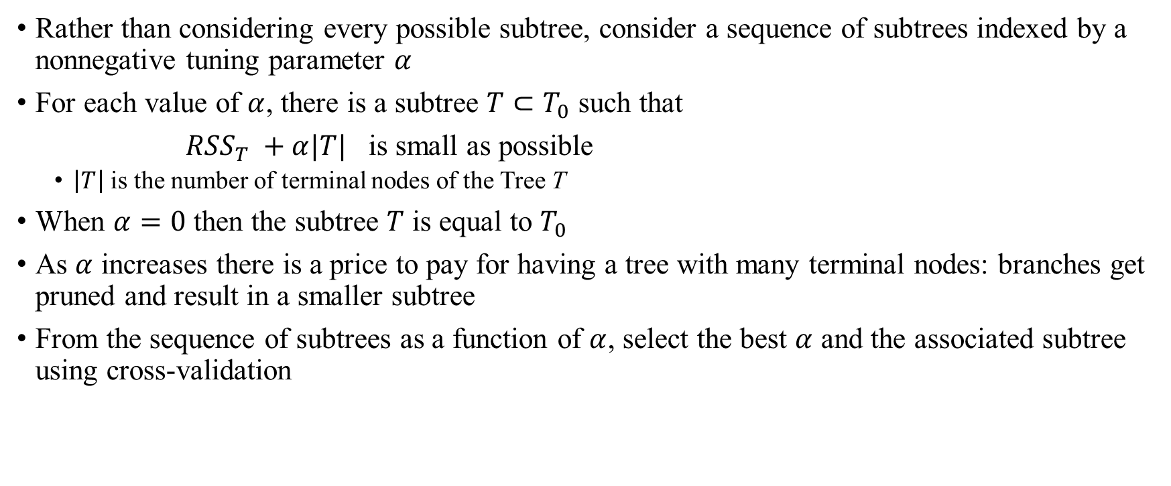
Cost Complexity Pruning
Rather than considering every possible subtree, consider a sequence of subtrees indexed by a nonnegative tuning parameter $α$
For each value of $α$, there is a subtree $T⊂T_{0}$ such that
$RSS_{T} +α|T|$ is small as possible
$\left|T\right|$ is the number of terminal nodes of the Tree T
When $α=0$ then the subtree $T$ is equal to $T_{0}$
As $α$ increases there is a price to pay for having a tree with many terminal nodes: branches get pruned and result in a smaller subtree
From the sequence of subtrees as a function of $α$, select the best $α$ and the associated subtree using cross-validation

Slide 59
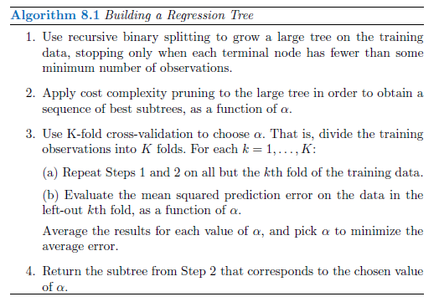
Building a Decision Tree

Slide 60
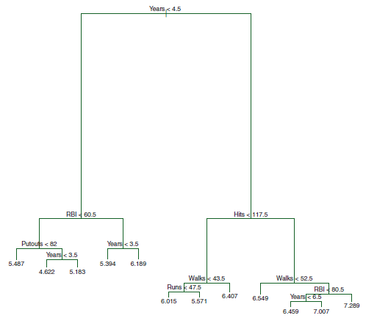
An Unpruned Tree

Slide 61
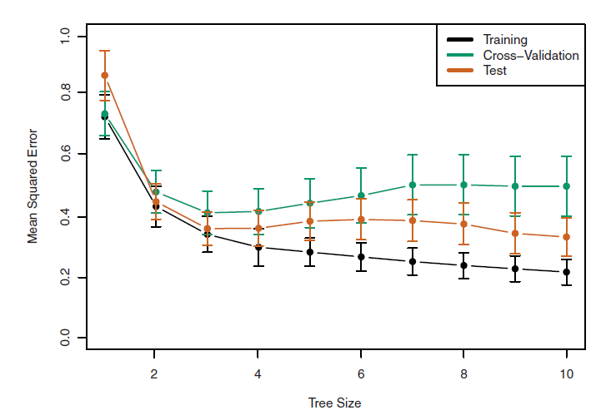
Trees and Cross-Validation

Slide 62
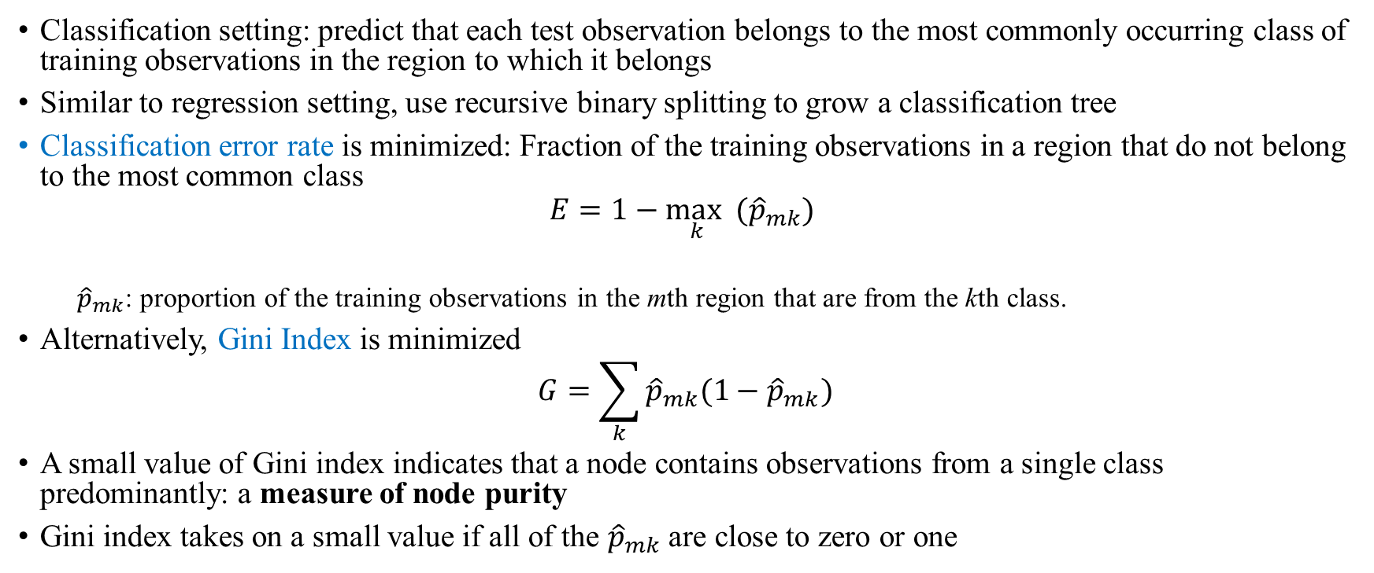
Decision Tree for Classification
Classification setting: predict that each test observation belongs to the most commonly occurring class of training observations in the region to which it belongs
Similar to regression setting, use recursive binary splitting to grow a classification tree
Classification error rate is minimized: Fraction of the training observations in a region that do not belong to the most common class
$$E=1−\max_{k} ({\hat{p}}_{mk})$$
${\hat{p}}_{mk}$: proportion of the training observations in the mth region that are from the kth class.
Alternatively, Gini Index is minimized
$$G=\sum_{k}{{\hat{p}}_{mk}(1−{\hat{p}}_{mk})}$$
A small value of Gini index indicates that a node contains observations from a single class predominantly: a measure of node purity
Gini index takes on a small value if all of the ${\hat{p}}_{mk}$ are close to zero or one

Slide 63
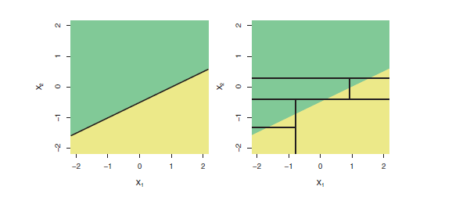
Linear Model vs Tree Model
Linear model fits better if the true decision boundary is linear

Slide 64
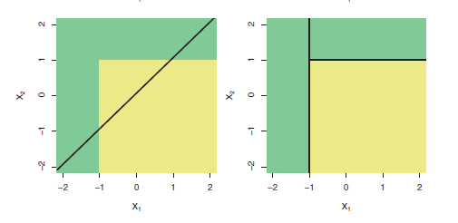
Linear Model vs Tree Model
Tree model fits better if the true decision boundary is complex and nonlinear

Slide 65
Advantages and Disadvantages of Trees
Advantages:
Trees are very easy to explain
Some believe that decision trees mirror human decision making than do the regression and classification approach
Trees can be displayed graphically and are easily interpreted
Disadvantages:
Trees generally do not have the same level of prediction accuracy as some of the regression and classification approaches
Trees can be non-robust: trees based on different training samples can be very different

Slide 66
Bagging, Random Forests, Boosting
Bagging, Random Forests, Boosting are powerful methods that use trees as building blocks
These methods have better predictive performance and overcome some of the disadvantages of trees
They are all emsemble methods
An emsemble method combines the predictions of many predictors

Slide 67
Bagging
Trees based on different subsamples can be very different – high variance model
Low variance models generate similar results when applied to different samples
Bootstrap aggregation, or bagging, is a general-purpose procedure for reducing the bagging variance of a statistical learning method

Slide 68
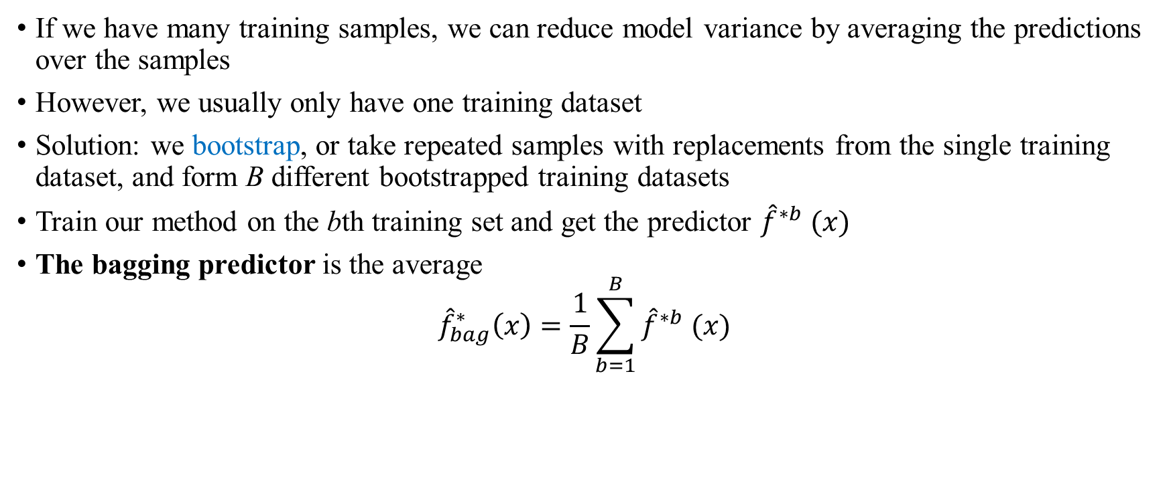
Bagging
If we have many training samples, we can reduce model variance by averaging the predictions over the samples
However, we usually only have one training dataset
Solution: we bootstrap, or take repeated samples with replacements from the single training dataset, and form B different bootstrapped training datasets
Train our method on the bth training set and get the predictor ${\hat{f}}^{∗b} (x)$
The bagging predictor is the average
$${\hat{f}}_{bag}^{∗}\left(x\right)=\frac{1}{B}\sum_{b=1}^{B}{{\hat{f}}^{∗b} (x)}$$

Slide 69
Bagging for Trees
Regressions
Construct B regressions trees using bootstrapped training samples
Take the average of the regression predictions from the B trees to obtain the bagging estimator
Classifications
Take the classifying predictions from B trees and select the category that receives the majority vote
Choice of Number of Trees
Large number B will not lead to overfitting
Choose a number B such that test error starts to settle down

Slide 70
Out-of-bag (OOB) errors
An observation is said to be out-of-the-bag (OOB) for a bootstrapped sample if it is not in the sample
For each observation, there are on average B/3 bootstrapped samples that do not contain it
Instead of cross-validation, we can calculate out-of-bag errors for bagging predictors
For each observation i, take the bagging estimator based on all bootstramped samples for which i is out-of-the-bag
Define the predicted value for i from this bagging estimator as the OOB prediction for observation i
Calculate MSE of the OOB predictions
This does not require costly cross-validation

Slide 71
Variable Importance
Disadvantage of bagging method: difficult to interpret the results
Variable importance: total amount of RSS/Gini decrease due to the splits by a certain predictor
Helps interpretation of variables

Slide 72
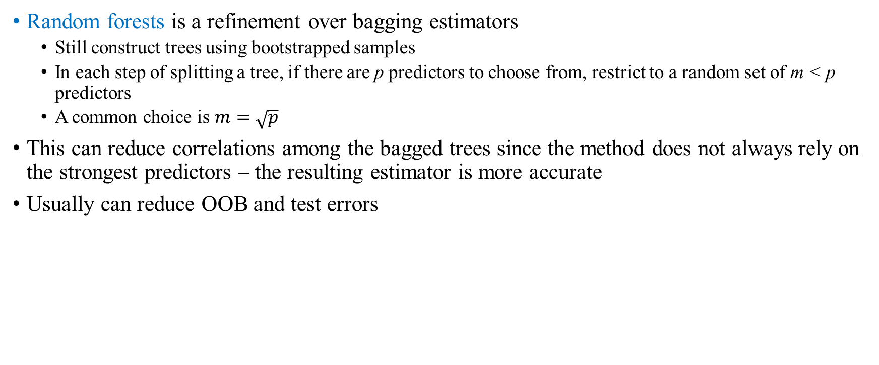
Random Forests
Random forests is a refinement over bagging estimators
Still construct trees using bootstrapped samples
In each step of splitting a tree, if there are p predictors to choose from, restrict to a random set of m < p predictors
A common choice is $m=\sqrt{p}$
This can reduce correlations among the bagged trees since the method does not always rely on the strongest predictors – the resulting estimator is more accurate
Usually can reduce OOB and test errors

Slide 73
Boosting
Boosting is also an emsemble predictor based on a set of decision trees over different samples
It does not use bootstrapped samples
The boosting trees and samples are constructed sequentially, each using information from the previous trees
Most popular boosting method is gradient boosting: in each step, a decision tree is formed to predict the residual error from the previous estimation

Slide 74
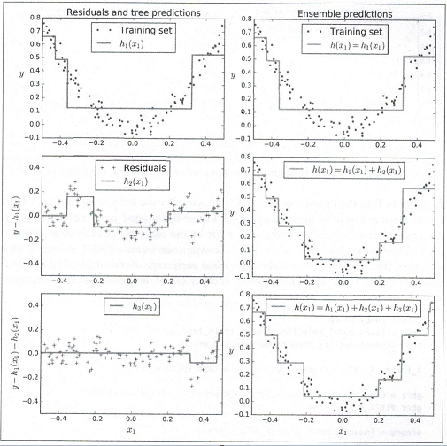
Gradient Boosting
Source: Geron (2017)

Slide 75
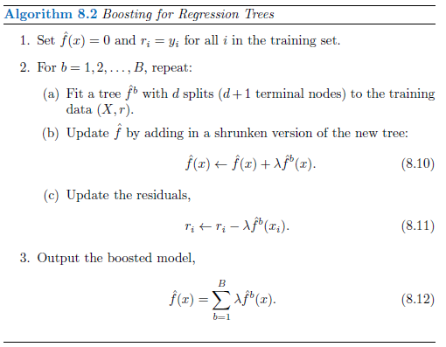
Gradient Boosting – Algorithm

Slide 76
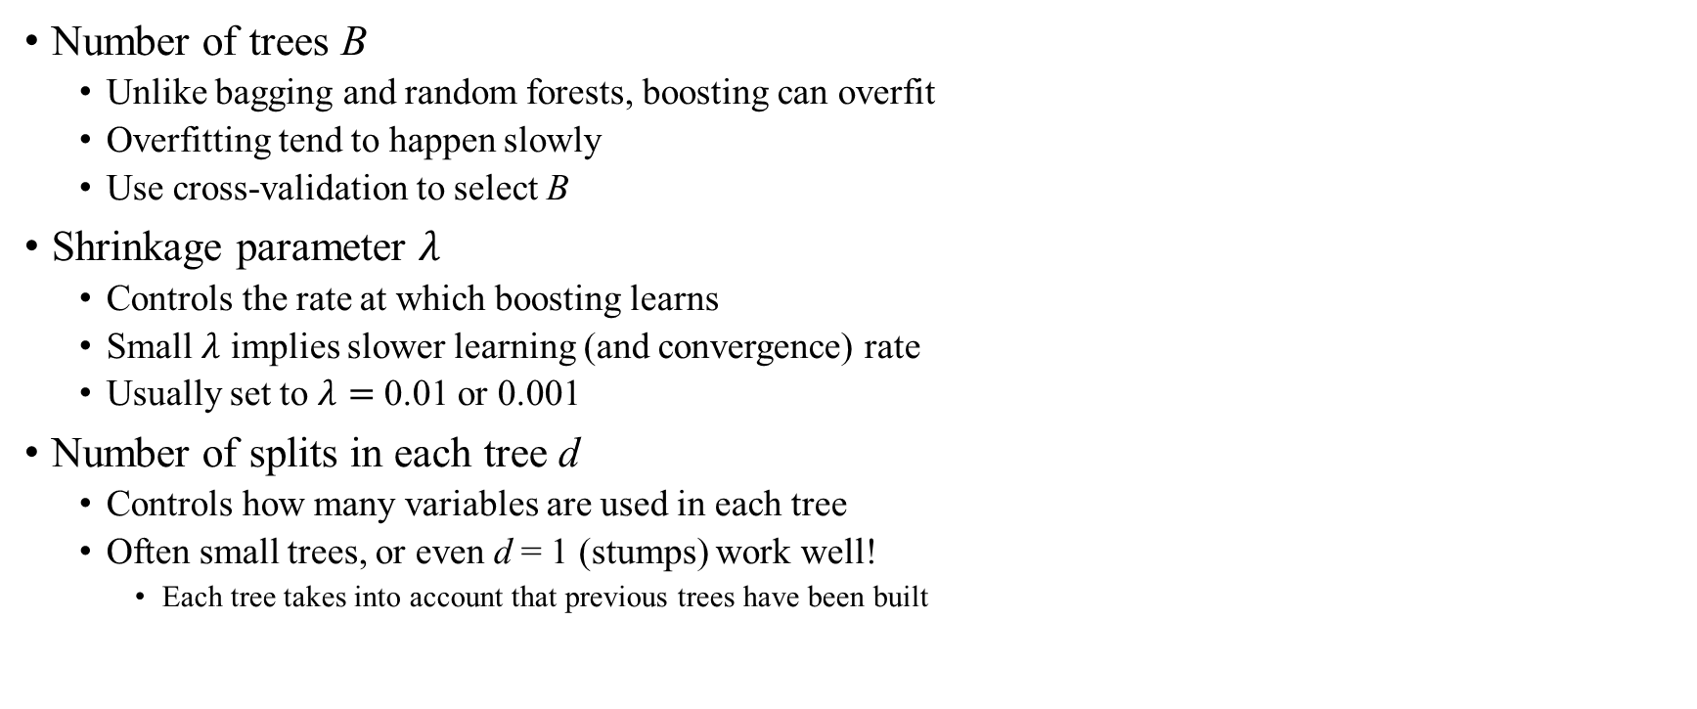
Gradient Boosting – Parameters
Number of trees B
Unlike bagging and random forests, boosting can overfit
Overfitting tend to happen slowly
Use cross-validation to select B
Shrinkage parameter $λ$
Controls the rate at which boosting learns
Small $λ$ implies slower learning (and convergence) rate
Usually set to $λ=$ 0.01 or 0.001
Number of splits in each tree d
Controls how many variables are used in each tree
Often small trees, or even d = 1 (stumps) work well!
Each tree takes into account that previous trees have been built

Slide 77
Support Vector Machines
Developed in 1990s
Performed well in a number of settings
Image Analysis
Text Analysis
Perform well even when the number of features is very large (e.g., in text analysis)
Considered one of the best “out of the box” classifiers, especially for small and medium datasets

Slide 78
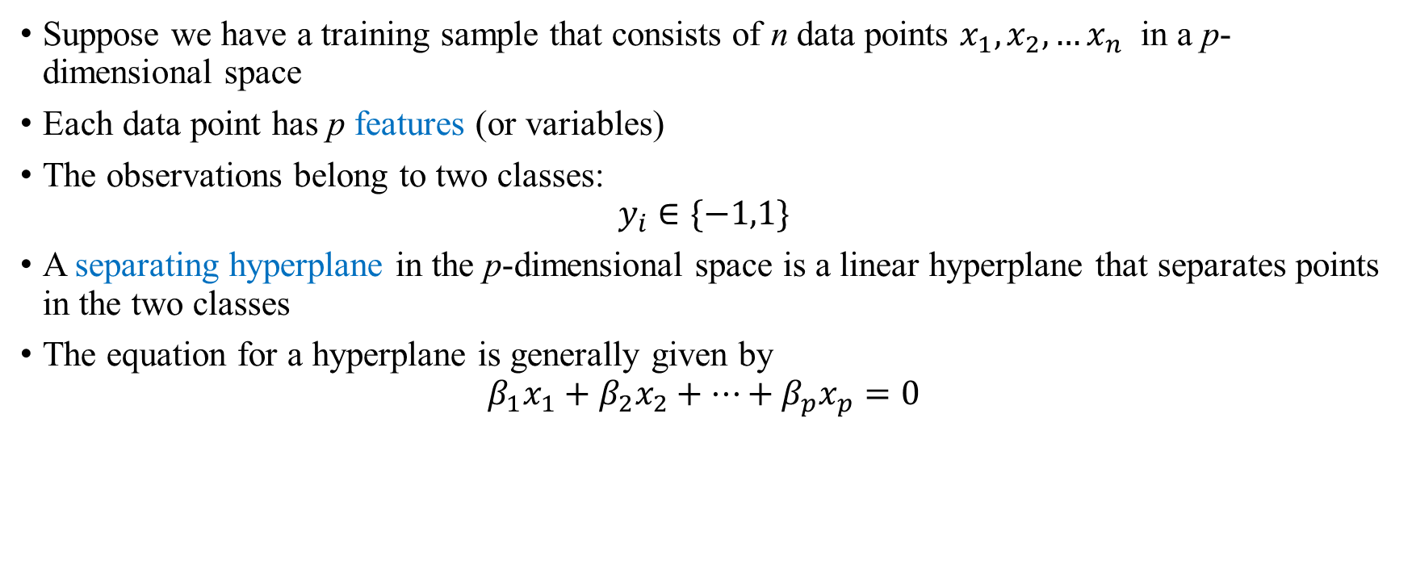
Separating Hyperplane
Suppose we have a training sample that consists of n data points $x_{1},x_{2},…x_{n}$ in a p-dimensional space
Each data point has p features (or variables)
The observations belong to two classes:
$$y_{i}∈\{−1,1\}$$
A separating hyperplane in the p-dimensional space is a linear hyperplane that separates points in the two classes
The equation for a hyperplane is generally given by
$$β_{1}x_{1}+β_{2}x_{2}+…+β_{p}x_{p}=0$$

Slide 79
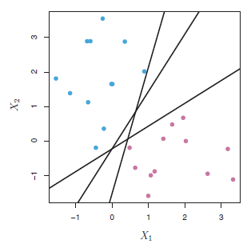
Separating Hyperplanes

Slide 80
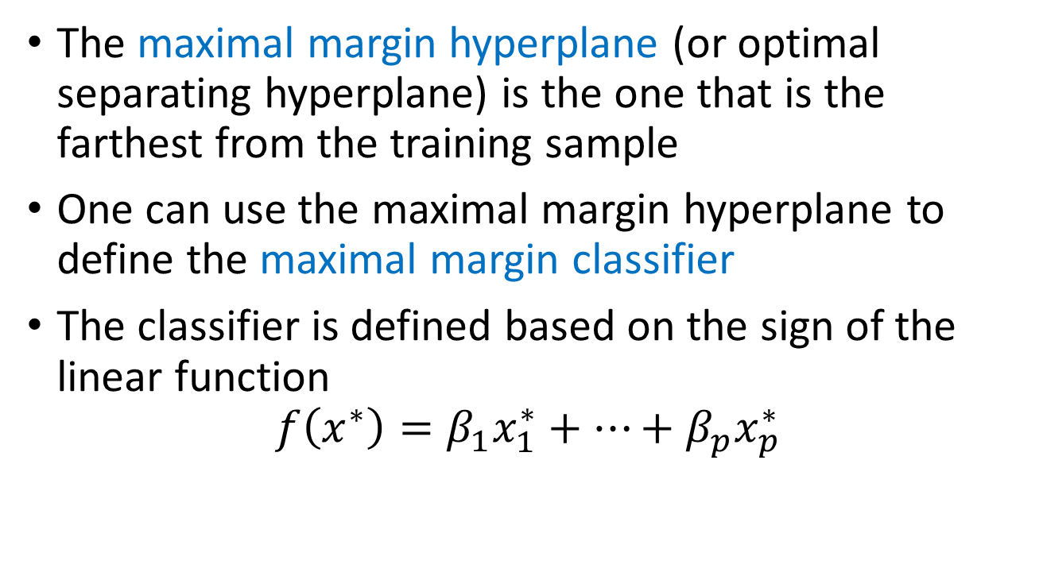
Maximal Margin Classifier
The maximal margin hyperplane (or optimal separating hyperplane) is the one that is the farthest from the training sample
One can use the maximal margin hyperplane to define the maximal margin classifier
The classifier is defined based on the sign of the linear function
$$f\left(x^{∗}\right)=β_{1}x_{1}^{∗}+…+β_{p}x_{p}^{∗}$$

Slide 81
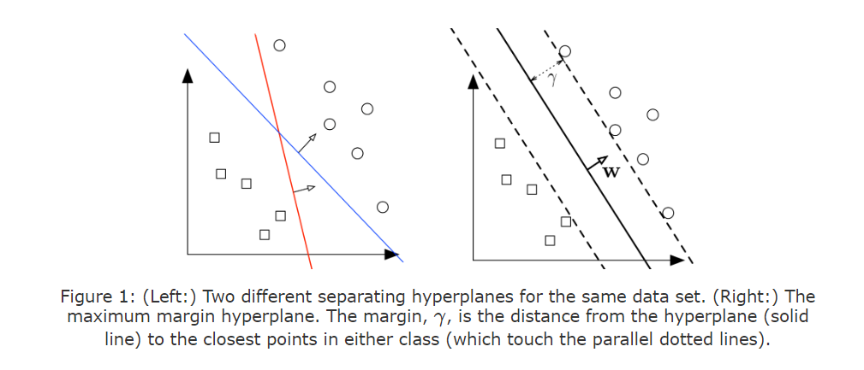
Question: What is the best separating hyperplane? SVM Answer: The one that maximizes the distance to the closest data points from both classes. We say it is the hyperplane with maximum margin.

Slide 82
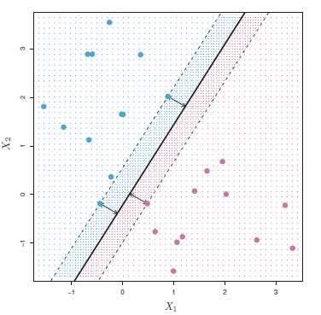
Maximal Margin Classifier
The maximal margin classifier only depends on the closest observations to it, or the support vectors, and not on other observations

Slide 83
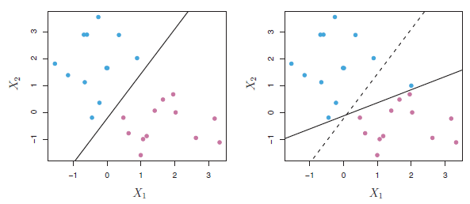
Maximal Margin Classifier
Maximal margin hyperplane can be sensitive to a single observation

Slide 84
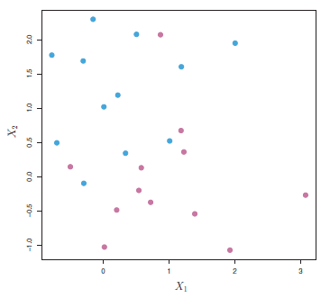
Maximal Margin Classifier
Maximal margin hyperplane does not exist if the data are not separable by hyperplanes

Slide 85
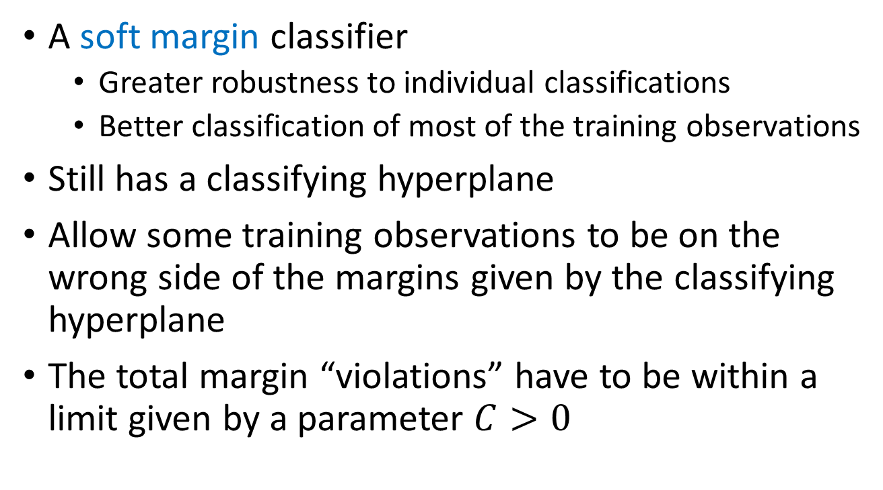
Support Vector Classifier
A soft margin classifier
Greater robustness to individual classifications
Better classification of most of the training observations
Still has a classifying hyperplane
Allow some training observations to be on the wrong side of the margins given by the classifying hyperplane
The total margin “violations” have to be within a limit given by a parameter $C>0$

Slide 86
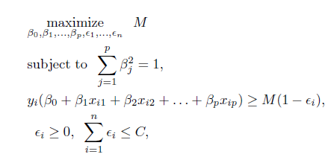
Support Vector Classifier
The classifying hyperplane is the solution to the following optimization problem

Slide 87
Support Vector Classifier
The parameter C is the bound for total margin violations and is a tuning parameter
It controls the bias-variance trade-off
Small values of C means the model has narrow margins and thus have low bias (in-sample errors) but high variance (potentially not performing well for the test sample)
Large values of C means the model have higher bias but low variance
SVC only depends on the support vectors, the observations that fall on the margin or on the wrong side of the margin

Slide 88
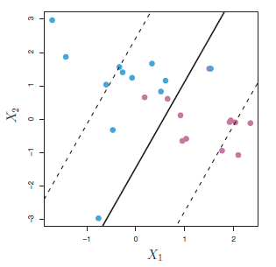
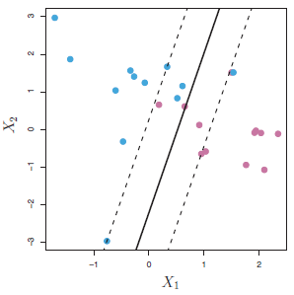
Support Vector Classifier
Large C value
Small C value

Slide 89
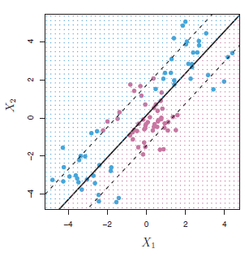
Support Vector Classifier - Non-linearity
The linear Support Vector Classifier can perform poorly if the boundary between the classes is nonlinear

Slide 90
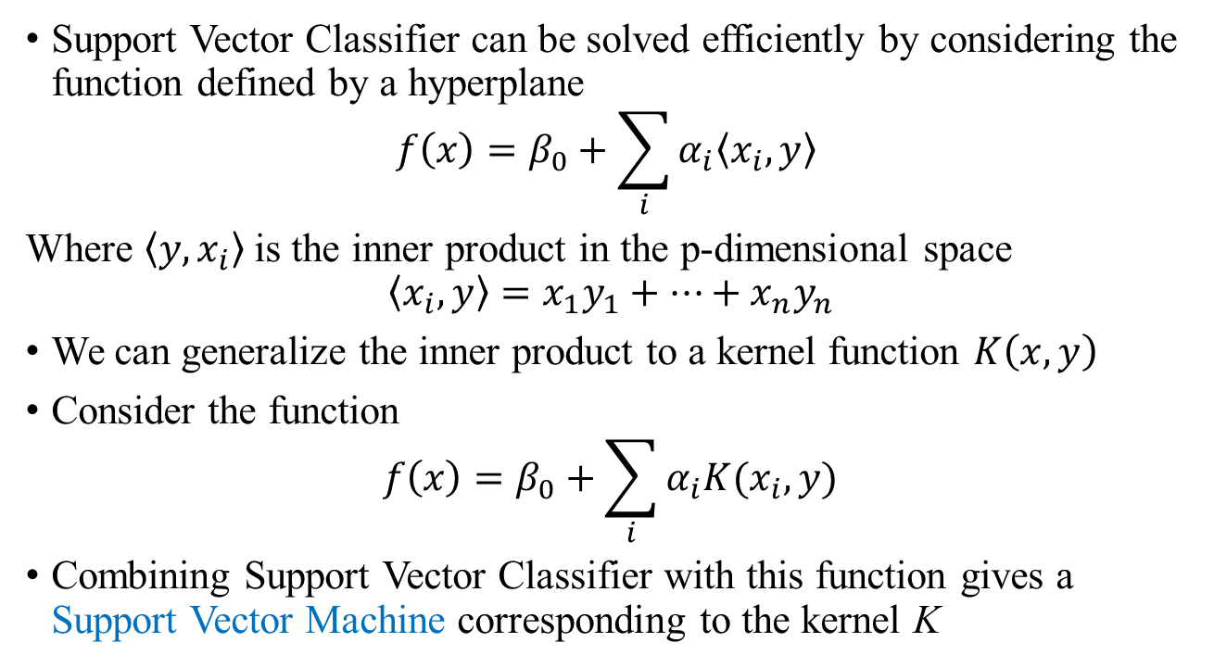
Support Vector Machines – Non-linearity
Support Vector Classifier can be solved efficiently by considering the function defined by a hyperplane
$$f\left(x\right)=β_{0}+\sum_{i}{α_{i}\left\langle x_{i}, y\right\rangle }$$
Where $\left\langle y,x_{i}\right\rangle$is the inner product in the p-dimensional space
$$\left\langle x_{i}, y\right\rangle =x_{1}y_{1}+…+x_{n}y_{n}$$
We can generalize the inner product to a kernel function $K\left(x, y\right)$
Consider the function
$$f\left(x\right)=β_{0}+\sum_{i}{α_{i}K(x_{i}, y)}$$
Combining Support Vector Classifier with this function gives a Support Vector Machine corresponding to the kernel K

Slide 91
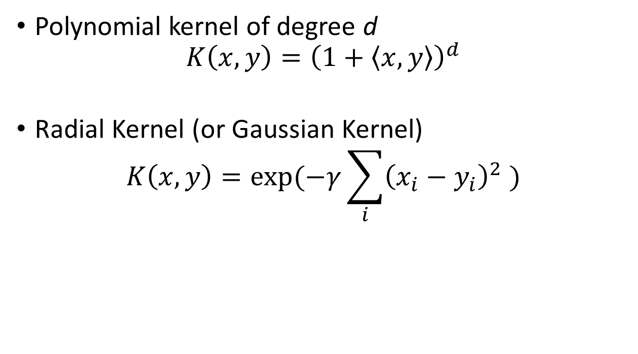
Examples of Support Vector Machines
Polynomial kernel of degree d
$$K\left(x,y\right)={\left(1+\left\langle x,y\right\rangle \right)}^{d}$$
Radial Kernel (or Gaussian Kernel)
$$K\left(x,y\right)=\exp{(−γ\sum_{i}{{\left(x_{i}−y_{i}\right)}^{2}} )}$$

Slide 92

Examples of Support Vector Machines
Polynomial Kernel of degree 3 Radial Kernel

Slide 93

Multiple Classes
What if there are $n>2$ classes? Rely on the 2-class classifiers
One-vs-one approach
Compare each pair of classes $(i,j)$
Choose the class that wins out in the most pairs
One-vs-all approach
Compare class $i$ vs the rest of other classes
Obtain a statistic $f_{i}(x)$ (“margin”)
For $x$, choose the class $i$ for which $f_{i}\left(x\right)$ is largest

Slide 94
Support Vector Machines
Has some deep connections and similarity to logistic regressions
Perform well when the categories are well separated
When classes overlap more, logistic regressions perform better
Perform well for data with a large number of features (e.g. textual analysis)
Also can be modified to conduct Support Vector Regressions
Parameter C is important

Slide 95

Deep Learning
Deep learning models are neural networks
Similar to other machine learning models, the goal is to approximate a function
$$y=f^{∗}(x)$$
Classification problem: the values of $y$ are discrete E.g., $x$ are pixels of a picture, and $y$ is the category of the picture
Regression problem: the values of $y$ are continuous
A deep learning model defines a mapping
$y=f(x;θ)$
and learns the parameter $θ$ that best approximates the function $y=f^{∗}\left(x\right).$

Slide 96


Deep Learning: Feedforward Networks
The simplest deep learning models are the feed forward networks or multilayer perceptrons (MLPs)
Each node is a relatively simple function
Input layer: components of $x$
Output layer: output, $y$
One or more more hidden layers:
Hidden layers are governed by
non-linear activation functions
Captures non-linear, higher levels
Features
Modeled after brains

Slide 97

Deep Learning: A Simple Example
Learning the XOR function (“exclusive or”)
The XOR function takes in two binary inputs $x_{1},x_{2}∈\{0,1\}$:
$$f^{∗}\left(x_{1},x_{2}\right)=\left\{\begin{matrix}1, if {(x}_{1},x_{2})=\left(0,1\right) or (1,0) \\ 0, otherwise \end{matrix}\right.$$
Want to train a function $y=f\left(x;θ\right)$ so that $f$ is close to $f^{∗}$ or to minimize the SSE
$$R\left(θ\right)=\sum_{x∈X}{{\left(f^{∗}\left(x\right)−f\left(x,θ\right)\right)}^{2}}$$

Slide 98



Deep Learning: A Simple Example
First, consider a linear model
$$f\left(x;w,b\right)=w_{1}x_{1}+w_{2}x_{2}+b$$
Minimizing SSE gives $w_{1}=w_{2}=0,$ and $b=\frac{1}{2}$
This function outputs $f=\frac{1}{2}$ for all inputs!
Why? The XOR function cannot
be represented by a linear model

Slide 99


Deep Learning: A Simple Example
Now consider a feedforward network with nonlinear functions
$h_{1}=g\left(W_{1}^{′}x+c_{1}\right),h_{2}=g\left(W_{2}^{′}x+c_{2}\right)$
$g$is the activation function
Default in modern neural networks:
$g\left(x\right)=max⁡(x,0)$, or the rectified
Linear unit (ReLU) function
$y=w_{1}h_{1}+w_{2}h_{2}+b$

Slide 100

The ReLU function

Slide 101


Deep Learning: A Simple Example
Solution
$h_{1}\left(x\right)=g\left(x_{1}+x_{2}\right),h_{2}\left(x\right)=g(x_{1}+x_{2}−1)$
$w_{1}=1,w_{2}=−2,b=0$ or $y(h)=h_{1}−2h_{2}$
($h_{1}\left(x\right),h_{2}\left(x\right))$ transforms a point $x$ to point $h$
In the $h−$space, the points are
linearly separable
The prediction is perfect
in this case

Slide 102

Deep Learning
In general, there can be many hidden units, $h_{1},…,h_{M}$ and many outputs $f_{1},…f_{K}$
$$h_{m}=g\left(α_{0m}+α_{m}^{′}x\right)$$
$$f_{k}=β_{0k}+β_{k}^{′}h$$
Parameters: $θ=(α_{1},…,α_{M},β_{1},…,β_{K},…)$
For regressions, we minimize the sum of squared errors
$$R\left(θ\right)=\sum_{i}{\sum_{k}{{\left(y_{ik}^{∗}−f_{k}(x_{i})\right)}^{2}}}$$
For classification we normally minimize cross-entropy:
$$R\left(θ\right)=−\sum_{i}{\sum_{k}{y_{ik}^{∗}\log{f_{k}(x_{i})}}}$$

Slide 103

Deep Learning
It is typically infeasible to find the global minimum, nor is it desirable (overfitting)
There are usually some common algorithms (e.g., gradient descent) that find a good approximate minimum
To avoid overfitting, one can use weight decay , or regularization, e.g., minimize
$$R\left(θ\right)+λJ(θ)$$
$$J\left(θ\right)=∑β_{km}^{2}+∑α_{ml}^{2}$$

Slide 104

Example of a Deep Learning Model
Source: Goodfellow et al. (2016)

Slide 105
Deep Learning
Deep learning has seen explosive growth in recent years
Many extensions over the simple fully connected feedforward network:
Convolutional neural networks (CNN)
Recurrent neural networks (RNN)
The most powerful method in many problems, especially with large datasets
genomics, natural language processing, image recognition, voice recognition, gaming AI, …

Slide 106
Large language model (LLM)
LLMs operate by leveraging deep learning techniques and vast amounts of textual data. These models are typically based on a transformer architecture, like the generative pre-trained transformer.
LLMs consist of multiple layers of neural networks, each with parameters that can be fine-tuned during training. These models learn to predict the next word in a sentence based on the context provided by the preceding words.
Model performance can also be increased through prompt engineering, fine-tuning and other tactics like reinforcement learning with human feedback (RLHF)
Use case: Text generation, Content summarization, AI assistants, Code generation, Sentiment analysis, Language translation

Slide 107

Large language model (LLM)

Slide 108

Retrieval-augmented Generation (RAG)
Generative AI and LLMs have token limits
➔ One can construct a custom RAG-LLM (Lewis et al., 2020, Adv. in Neural Info. Processing Systems)
Open-source components:
Semantic embedding: sentence-transformers/all-mpnet-base-v2
Vectorstore: ChromaDB
Vectorstore/LLM linking interface: LangChain
Main LLM: https://huggingface.co/NexusFlow/Starling-LM-7B-beta

Slide 109
Artificial Intelligence (AI) Technologies Displacement or Augmentation? The Effects of AI on Workforce Dynamics and Firm Value Chen and Wang (2024)

Slide 110
Functional Categories of AI
Builds on parallels between AI capabilities and human intelligence
Turing’s “Imitation Game” (1950)
Dartmouth Summer Conference (1956)
Functional Category
Tasks and Capabilities
Examples of AI Applications
Perception
Inference
Prediction
Creativity
Engagement
Image generation; text generation; art generation
Machine learning; deep learning models
Logical reasoning; heuristic inference
Image recognition; object recognition; speech recognition
Interactive chat; interactive content generation
Computer vision systems; autonomous vehicle systems; diagnostic medical imaging
Expert systems; AlphaGo; automated reasoning systems; C++ coding assistants
AlphaFold protein prediction; fraud detection systems
ChatGPT; Adobe art generator; OpenAI Sora video generator
Siri; Cortana; Alexa; ChatGPT; customer service AI; videogame NPCs

Slide 111
Distribution of Artificial Intelligence Patents Across Functional Categories

Slide 112

Creativity AI
The FT report notes that generative AI’s entry into the legal world could lead to job losses and reduced revenue by cutting billable hours and entry-level work.
As PYMNTS wrote last month, the widespread adoption of generative AI in the legal industry will mean reconfiguring a number of roles and skills in this space.
https://www.pymnts.com/artificial-intelligence-2/2023/law-firm-allen-and-overy-debuts-ai-contract-negotiation-tool/

Slide 113

Inference AI
Developed by Deloitte’s AI Institute, PairD is an internal generative AI (Gen AI) platform designed to help its workforce with day-to-day tasks, including drafting content, writing code and carrying out research safely and securely.
https://aimagazine.com/machine-learning/deloitte-introduces-paird-ai-chatbot-for-its-workforce

Slide 114

Generative AI
“Our expanded partnership with Cognizant will help organizations harness generative AI to transform business operations, enhance employee experiences, and deliver new value for customers,” said Judson Althoff, executive vice president and chief commercial officer at Microsoft.
https://news.microsoft.com/2024/04/22/cognizant-and-microsoft-announce-global-partnership-to-expand-adoption-of-generative-ai-in-the-enterprise-and-drive-industry-transformation/

Slide 115

Inference AI
Google's medically focused AI model (Med-PaLM2) scored 85%+ when answering US Medical Licensing Examination–style questions. That's an "expert" physician level and far beyond the accuracy threshold needed to pass the actual exam.
The Medscape 2023 Physician and AI Report surveyed 1043 US physicians about their views on AI. In total, 65% are concerned about AI making diagnosis and treatment decisions, but 56% are enthusiastic about having it as an adjunct.
https://distilledscience.medium.com/ai-in-healthcare-med-palm-2-surpasses-human-doctors-in-medical-knowledge-assessment-4087bf4b9006
https://www.medscape.com/viewarticle/are-you-ready-ai-be-better-doctor-than-you-2024a100070q?form=fpf

Slide 116

Prediction/Inference AI
By providing financial advisers with quick access to the bank’s extensive database of research reports and documents, the AI @ Morgan Stanley Assistant will save advisers and customer service employees time in addressing queries related to markets, recommendations and internal processes
According to the CNBC report, Morgan Stanley Co-President Andy Saperstein said in the memo: “Financial advisers will always be the center of Morgan Stanley wealth management’s universe. We also believe that generative AI will revolutionize client interactions, bringing new efficiencies to adviser practices, and ultimately help free up time to do what you do best: serve your clients.”
https://www.pymnts.com/artificial-intelligence-2/2023/morgan-stanley-to-launch-ai-powered-assistant-for-financial-advisors/

Slide 117

Creativity AI
Magic Studio features like Magic Switch automatically convert your designs into blogs, social media posts, emails, and more to save time on manually editing documents.
we've seen this first hand with the likes of companies including Zoom, Salesforce, and FedEx adopting Canva for their teams. These companies are seeing the benefits of having a simplified platform with all the essential tools in place for their employees to create their best work,” said Clark, the Europe Lead of Canva.
https://www.theverge.com/2023/10/4/23902794/canva-magic-studio-ai-design-new-tools

Slide 118

Perception AI
The solution monitors security camera footage and identifies hardhats, high visibility vests, work goggles, shoes and even special protection belts that are required for workers working at high altitudes.
Solution by AGMIS can also monitor vehicle and person access onto company premises, monitor construction worker movement in the construction site, identify if construction materials are optimally laid out, identify certain worker actions – such as when worker requires assistance – and measure the exact time for performing certain manual tasks (for example, welding).
https://agmis.com/computer-vision-ai-ensures-worker-safety-in-industrial-and-construction-sites/

Slide 119

Engagement AI
The initiative by the Swedish furniture giant is aimed at expanding its range of home improvement services while delegating routine customer inquiries to an artificial intelligence (AI) bot named Billie, Reuters reported.
“We’re committed to strengthening co-workers’ employability in Ingka through lifelong learning and development and reskilling, and to accelerate the creation of new jobs,” Ingka Group Global People and Culture Manager Ulrika Biesert told Reuters.
https://www.pymnts.com/news/retail/2023/ikea-uses-artificial-intelligence-transform-call-center-employees-into-interior-design-advisors/

Slide 120

Engagement AI
Walmart has now joined the pack, giving access to its generative AI tool to more than 50,000 corporate employees.
The company said it does not believe generative AI will take over for workers, but rather serve as a tool to allow employees to spend less time on monotonous, repetitive tasks.
https://www.ciodive.com/news/Walmart-generative-AI-tool-My-Assistant/692385/#:~:text=Walmart%20has%20now%20joined%20the,time%20on%20monotonous%2C%20repetitive%20tasks.

Slide 121

Engagement AI
In December, Klarna announced a hiring freeze, except for engineering roles as it looked to AI.
A spokesperson told Tech.EU this would be reduced to around 2,300 workers due to the success of the AI-powered bot.
https://www.euronews.com/next/2024/02/28/klarnas-ai-bot-is-doing-the-work-of-700-employees-what-will-happen-to-their-jobs

Slide 122
Reference
Gareth James, Daniela Witten, Trevor Hastie, and Robert Tibshirani, 2013, An Introduction to Statistical Learning with Applications in R, Springer, 6th edition
Chen, M. A., & Wang, J. X. (2024). Displacement or Augmentation? The Effects of AI on Workforce Dynamics and Firm Value. The Effects of AI on Workforce Dynamics and Firm Value (April 8, 2024).

